Slide 1
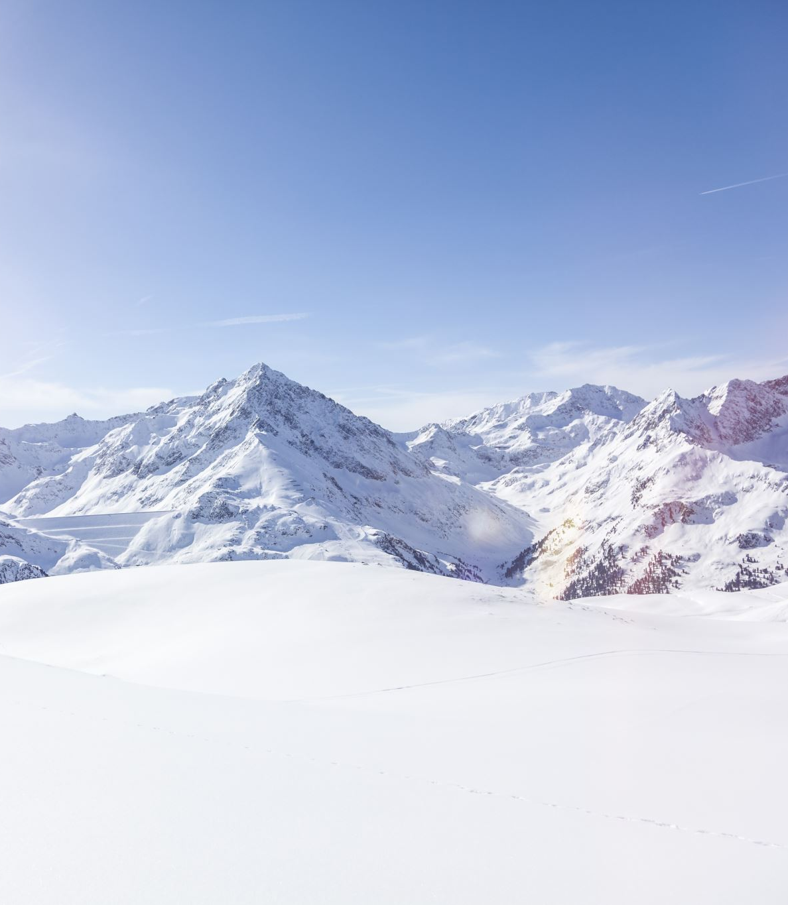
Big Mountain Resort
What is a good market price for lift tickets?

Slide 2
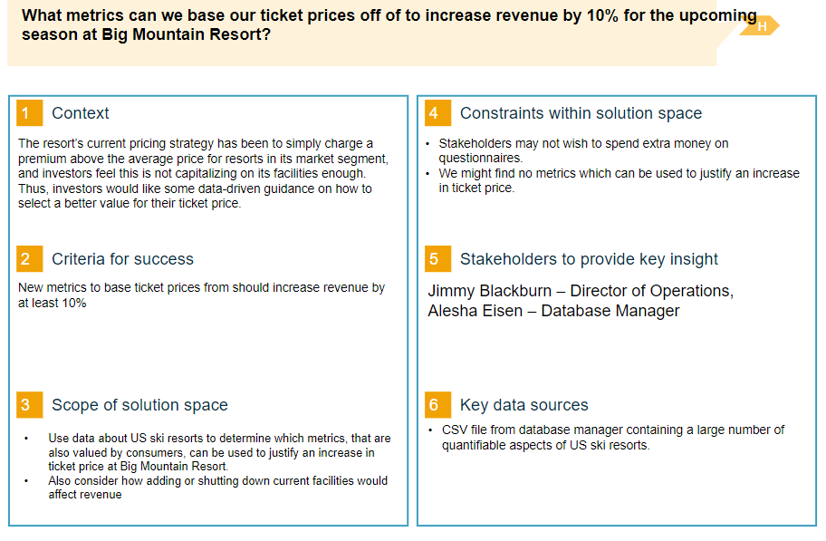
Problem Identification

Slide 3
Recommendation and key findings
Recommendation:
Random forest regressor model recommends a ticket price of $95.87
Mean absolute error: $10.39
Consider:
add run with chairlift to increase vertical drop by 150 feet
This scenario increases support for ticket price by $1.99
Over the course of a season, this could be expected to amount to $3,474,638.

Slide 4
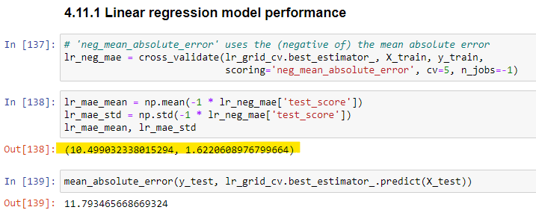
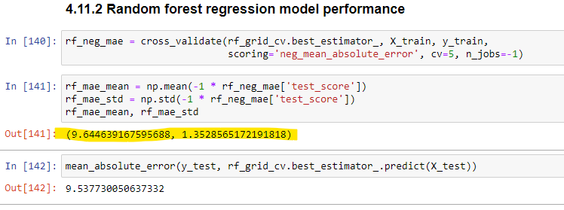
Modeling results and analysis
Why did we choose random forest regressor model?
Lower cross-validation mean absolute error by almost $1
Less variability

Slide 5
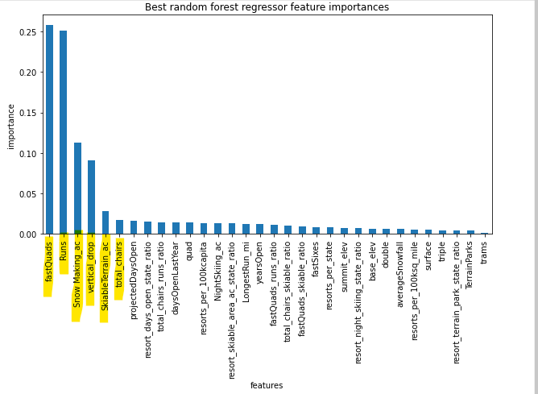
Modeling results and analysis
Which features are most important in determining price?

Slide 6
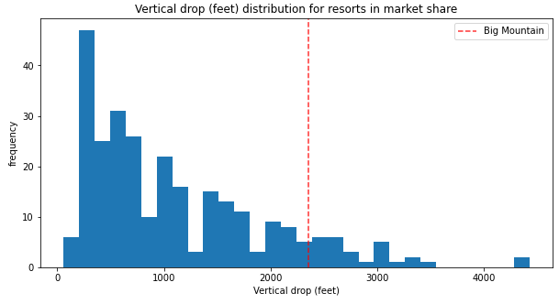
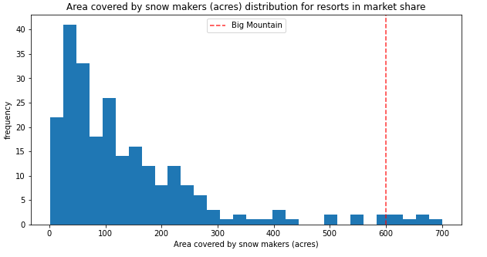
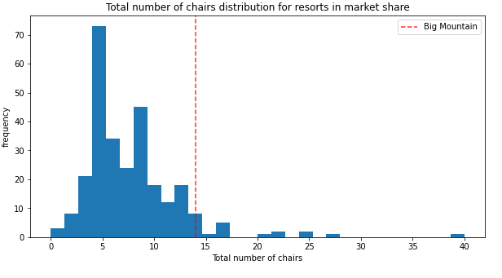
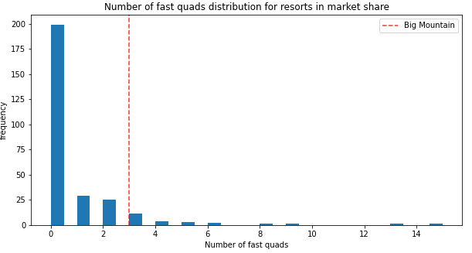
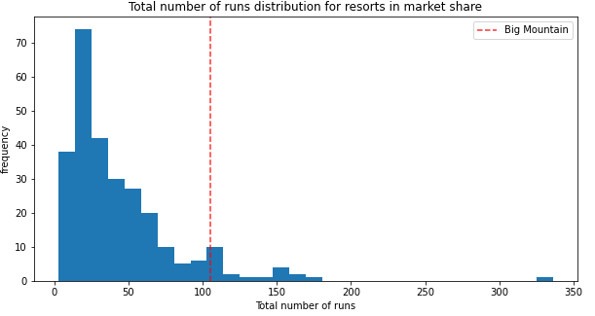
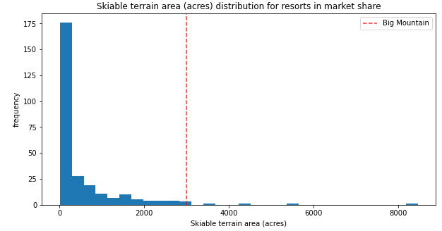
Modeling results and analysis
Which features of BMR justify a higher ticket price?

Slide 7
Summary and conclusion
Current ticket price of $81 is undervalued given the facilities at BMR and the current market
Our model suggests a new ticket price of $95.87
And with a MAE of $10.39, there is room for a further increase
We could further increase our ticket price by $1.99 by adding a run with a chairlift that would increase vertical drop by 150 feet

